Slide 1
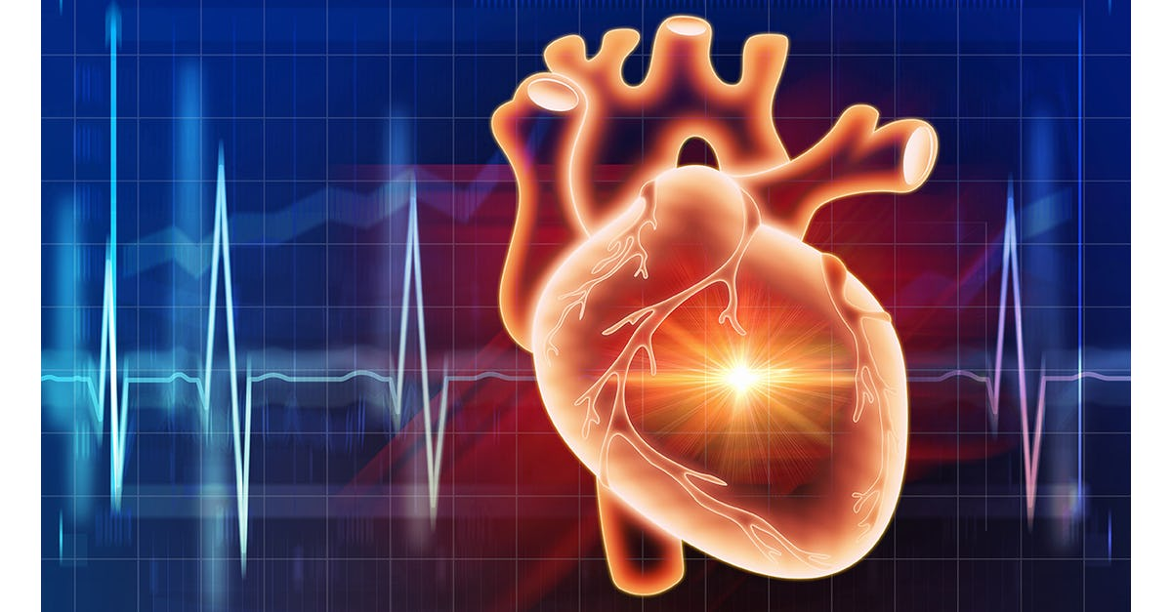

Heart Disease Analysis and Prediction.
Presented by Offor Amarachi
@
Redi School Munich
Data Analytics
31.05.2022

Slide 2

CONTENT
INTRODUCTION
AIMS AND OBJECTIVES
MATERIALS AND METHOD
RESULT
CONCLUSION

Slide 3
1.0 INTRODUCTION
Heart Disease
Causes:
Overweight/Obesity
High blood pressure, diabetes,
Inactivity
Angina
High cholesterol

Slide 4
2.0 AIMS AND OBJECTIVES
Attributes analysis
Visualization and statistical test
Machine learning model and prediction

Slide 5
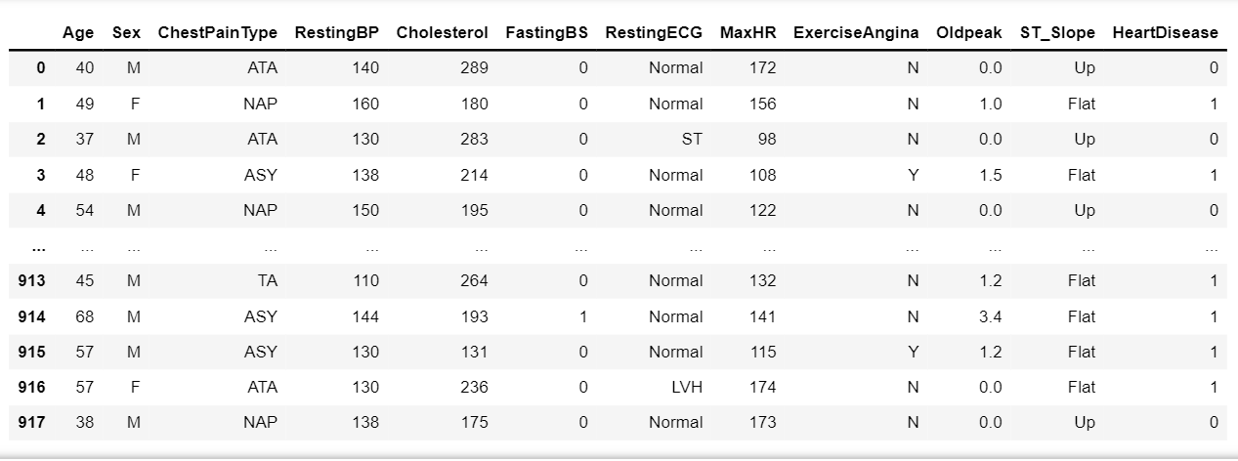
3.0 MATERIAL AND METHOD

Slide 6

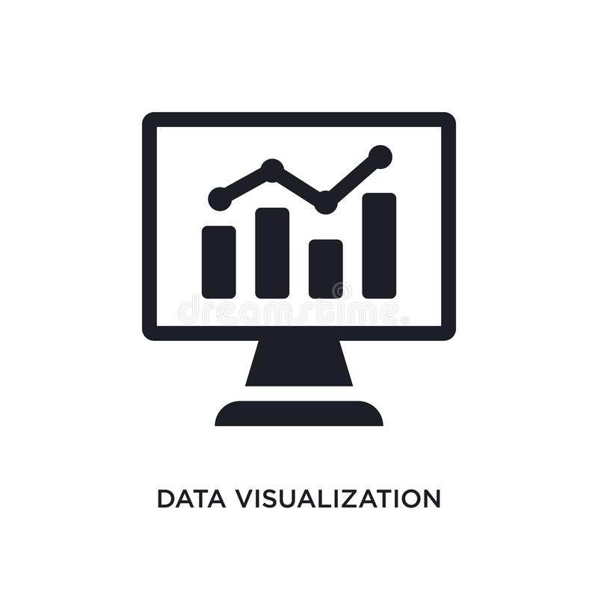


3.0. MATERIAL AND METHOD
https://www.kaggle.com/datasets/fedesoriano/heart-failure-prediction?select=heart.csv

Slide 7
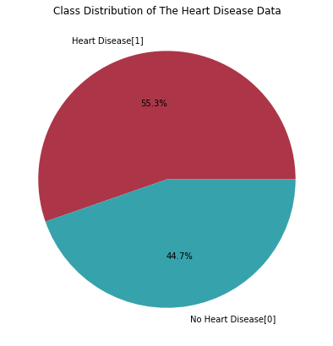
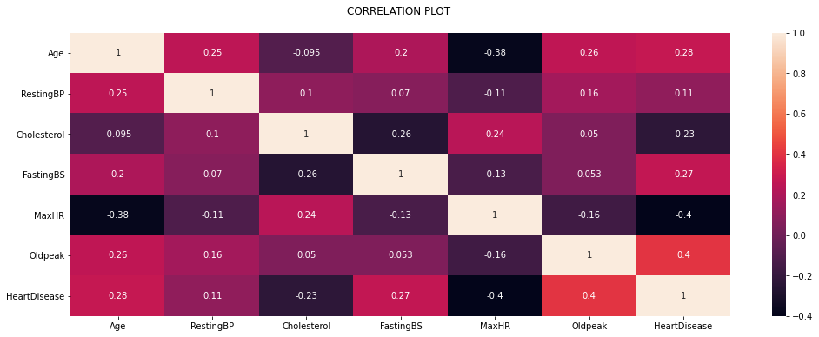
4.0 RESULT (VISUALIZATION)

Slide 8
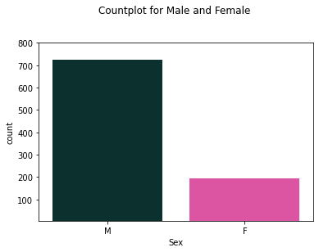
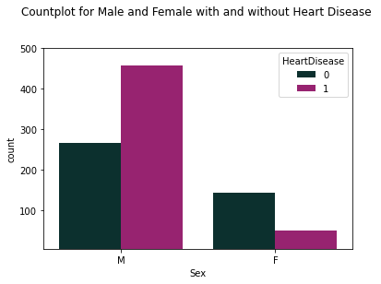
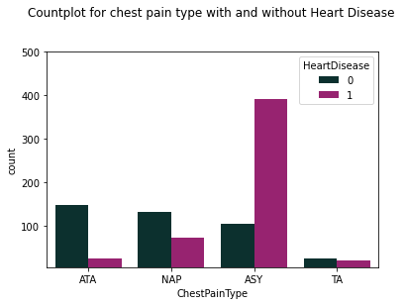
4.0 VISUALIZATION

Slide 9
STATISTICAL TEST High Cholesterol vs Heart Disease …Cholesterol level above 240mm/Hg could cause heart disease. Chi-Square test
chi2 stat | 45.209757970658
P-value | 1.770208618261378e-11
Degree of Freedom | 1

Slide 10
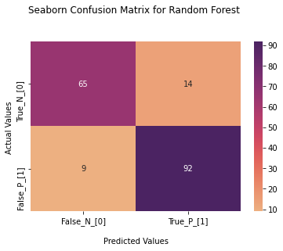
MACHINE LEARNING MODELLING
Models | Accuracy | F1_Score
Logistic Regression | 0.861111 | 0.86
K Nearest Neighbours | 0.844444 | 0.84
Support Vector Machine | 0.850000 | 0.85
Random Forest | 0.861111 | 0.86
Decision Tree | 0.766667 | 0.77
Naïve Bayes | 0.850000 | 0.85

Slide 11
CONCLUSION
50% of the patients have heart disease, with majority of male.
Most of the patients have ASY chest pain.
Heart disease prediction helps in management of cardiovascular diseases and prevent life threatening conditions.
Logistic regression model and Random forest model have the highest accuracy of 0.86 with f1_score of 0.86 and are the preferred model for this prediction.

Slide 12

THANK YOU
Offor Amarachi
Data Analytics

